Slide 1

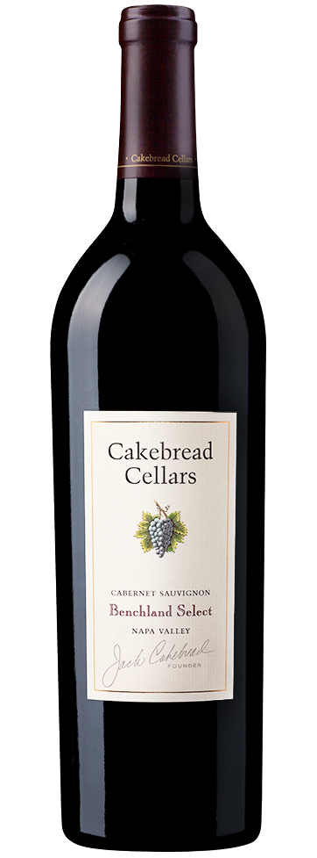
2023 BENCHLAND SELECT CABERNET SAUVIGNON
NAPA VALLEY
The 2023 Benchland Select Cabernet Sauvignon captivates with layered aromas of ripe cherry and red currant, unfolding into notes of dried sage, cigar box, and clove. The palate is plush and expressive, with concentrated flavors of black cherry, dark plum, and blackberry, enriched by fig jam and a floral lift of violet. Full bodied with finely knit tannins, this wine provides a seamless frame, carrying the wine through a long, polished finish marked by vibrant fruit and subtle baking spice.
VINEYARDS & VINTAGE
Fruit for the Benchland Select Cabernet Sauvignon is sourced from benchland vineyards in the Oakville and Rutherford AVA’s. These vineyards are rooted in Bale loam soils, prized for their excellent drainage and ability to retain sufficient moisture to support even vine growth and ripening. Located along the western benchlands, the sites benefit from a slightly cooler microclimate, with protection from intense afternoon heat. The resulting slow, steady maturation preserves natural acidity and promotes balanced flavor development, contributing to wines of depth, complexity, and structure.
Ample winter and spring rainfall in 2023 replenished vineyard soils and supported healthy vine growth over the extended growing season. Moderate summer temperatures allowed fruit to ripen slowly and evenly. Warm days paired with cool evenings in September and October refined the Cabernet Sauvignon grapes, enhancing aromatic complexity and flavor development. The mild conditions of the vintage resulted in fully ripe fruit with moderate sugar levels and lively acidity.
WINEMAKING
Fruit was hand-harvested in the early morning to preserve freshness and acidity, then gently destemmed and sorted for quality. A two-day cold soak enhanced aroma, flavor, and tannin extraction before fermentation in a combination of stainless steel tanks and concrete towers. Phenolic development was closely monitored throughout fermentation to achieve balance, concentration, and refined tannin structure before being aged in French oak barrels for 22 months.
GRAPE VARIETY
100% Cabernet Sauvignon
VINEYARDS
100% Napa Valley
HARVEST DATES
October 4-November 1, 2023
WINEMAKER
Niki Williams
NOTES
ALCOHOL | 14.5%
ACIDITY | .605/100 ml
PH | 3.67
BOTTLED | July 2025
AGING | 22 months in French oak barrels: 52% new, 48% neutral
WWW.CAKEBREAD.COM

